Slide 1

Number systems
By Krishna Chakravarty
Associate Professor
KIIT Deemed to be University

Slide 2
contents
Day 3
Introduction
Decimal number system
Binary number systems
Octal number system
Hexadecimal number system
Conversions to decimal
Conversions from decimal
Other conversions and shortcuts
Binary arithmatics

Slide 3
introduction
When we type some letters or words, the computer translates them in numbers as computers can understand only numbers.
The value of each digit in a number can be determined using −
The digit
The position of the digit in the number
The base of the number system

Slide 4
Base , weighting factor
BASE or Radix
In mathematical numeral systems, the radix or base is the number of unique digits, including zero, used to represent numbers in a positional numeral system. For example, for the decimal system (the most common system in use today) the radix is ten, because it uses the ten digits from 0 through 9.
Base 2 : 0 and 1
Base 8 : 0, 1, 2, 3, 4, 5, 6, 7
Base 10 : 0, 1, 2, 3, 4, 5, 6, 7, 8, 9
Weighting factor
Weight of a respective position. I
In decimal form, weight of each digit increases by a factor of 10 as one moves to the left.
754 = 7*100 + 5 *10 + 4

Slide 5
Decimal Number systems
Decimal Number System
Decimal number system has base 10 as it uses 10 digits from 0 to 9.
In decimal number system, the successive positions to the left of the decimal point represent units, tens, hundreds, thousands, and so on.
Each position represents a specific power of the base (10). For example, the decimal number 1234 consists of the digit 4 in the units position, 3 in the tens position, 2 in the hundreds position, and 1 in the thousands position. Its value can be written as
1234
=1000 + 200 + 30 + 4
= (1 x 1000)+ (2 x 100)+ (3 x 10)+ (4 x l)
=(1 x 10³)+ (2 x 10²)+ (3 x 10¹)+ (4 x l0⁰)

Slide 6
Computer number systems
S.No. | Number System and Description
1 | Binary Number System Base 2. Digits used : 0, 1
2 | Octal Number System Base 8. Digits used : 0, 1, 2, 3, 4, 5, 6, 7
3 | Hexa Decimal Number System Base 16. Digits used: 0 , 1, 2, 3, 4, 5, 6, 7, 8, 9, Letters used : A, B, C, D, E, F

Slide 7
BINARY number SYSTEM
Characteristics of the binary number system are as follows −
Uses two digits, 0 and 1
Also called as base 2 number system
First position in a binary number represents a 0 power of the base (2). Example 2⁰
Last position in a binary number represents a x power of the base (2). Example 2^{x} where x represents the last position - 1.
101010 binary
=( 32*1) + (16*0) + (8*1) +(4*0) + (2*1) + 1*0)
= 32 +8 + 2 = 42
1 | 0 | 1 | 0 | 1 | 0
2⁵ | 2⁴ | 2³ | 2² | 2¹ | 2⁰
32 | 16 | 8 | 4 | 2 | 1

Slide 8
BINARY number SYSTEM
Example
Binary Number: 10101₂
Calculating Decimal Equivalent −
Note − 10101₂ is normally written as 10101.
Step | Binary Number | Decimal Number
Step 1 | 10101₂ | ((1 x 2⁴) + (0 x 2³) + (1 x 2²) + (0 x 2¹) + (1 x 2⁰))₁₀
Step 2 | 10101₂ | (16 + 0 + 4 + 0 + 1)₁₀
Step 3 | 10101₂ | 21₁₀

Slide 9
octal number SYSTEM
Characteristics of the octal number system are as follows −
Uses eight digits, 0,1,2,3,4,5,6,7
Also called as base 8 number system
First position in an octal number represents a 0 power of the base (8). Example 8⁰
Last position in an octal number represents a x power of the base (8). Example 8^{x} where x represents the last position – 1
2 | 3 | 5
2*8² | 3*8¹ | 5*8⁰
2*64 | 3*8 | 5*1
128 | 24 | 5
Octal 235
= decimal (32 + 24 + 5)
= decimal 157

Slide 10
octal number SYSTEM
Example
Octal Number: 12570₈
Calculating Decimal Equivalent −
Step | Octal Number | Decimal Number
Step 1 | 12570₈ | ((1 x 8⁴) + (2 x 8³) + (5 x 8²) + (7 x 8¹) + (0 x 8⁰))₁₀
Step 2 | 12570₈ | (4096 + 1024 + 320 + 56 + 0)₁₀
Step 3 | 12570₈ | 5496₁₀

Slide 11
hexadecimal number SYSTEM
Characteristics of the hexadecimal number system are as follows
Uses 10 digits and 6 letters, 0, 1, 2, 3, 4, 5, 6, 7, 8, 9, A, B, C, D, E, F
Letters represent the numbers starting from 10. A = 10. B = 11, C = 12, D = 13, E = 14, F = 15
Also called as base 16 number system
First position in a hexadecimal number represents a 0 power of the base (16). Example, 16⁰
Last position in a hexadecimal number represents a x power of the base (16). Example 16^{x} where x represents the last position – 1

Slide 12
hexadecimal number SYSTEM
Hexadecimal Number: 19FDE₁₆
Calculating Decimal Equivalent −
Note − 12570₈ is normally written as 12570..
Step | Hexa Number | Decimal Number
Step 1 | 19FDE₁₆ | ((1 x 16⁴) + (9 x 16³) + (F x 16²) + (D x 16¹) + (E x 16⁰))₁₀
Step 2 | 19FDE₁₆ | ((1 x 16⁴) + (9 x 16³) + (15 x 16²) + (13 x 16¹) + (14 x 16⁰))₁₀
Step 3 | 19FDE₁₆ | (65536+ 36864 + 3840 + 208 + 14)₁₀
Step 4 | 19FDE₁₆ | 106462₁₀

Slide 13
More examples conversion to decimal
Binary to decimal
10111₂ = 1×2⁴+0×2³+1×2²+1×2¹+1×2⁰ = 16+0+4+2+1= 23
100011₂ = 1×2⁵+0×2⁴+0×2³+0×2²+1×2¹+1×2⁰ =32+0+0+2+1= 35

Slide 14
More examples conversion to decimal
Octal to decimal
27₈ = 2×8¹+7×8⁰ = 16+7 = 23
30₈ = 3×8¹+0×8⁰ = 24
4307₈ = 4×8³+3×8²+0×8¹+7×8⁰= 2247

Slide 15
More examples conversion to decimal
Hexadecimal to decimal
28₁₆ = 2×16¹+8×16⁰ = 40
2F₁₆ = 2×16¹+15×16⁰ = 47
BC12₁₆ = 11×16³+12×16²+1×16¹+2×16⁰= 48146

Slide 16
Conversion table
Decimal Base-10 | BinaryBase-2 | OctalBase-8 | HexadecimalBase-16
0 | 0 | 0 | 0
1 | 1 | 1 | 1
2 | 10 | 2 | 2
3 | 11 | 3 | 3
4 | 100 | 4 | 4
5 | 101 | 5 | 5
6 | 110 | 6 | 6

Slide 17
Conversion table
Decimal Base-10 | BinaryBase-2 | OctalBase-8 | HexadecimalBase-16
7 | 111 | 7 | 7
8 | 1000 | 10 | 8
9 | 1001 | 11 | 9
10 | 1010 | 12 | A
11 | 1011 | 13 | B
12 | 1100 | 14 | C

Slide 18
Conversion table
Decimal Base-10 | BinaryBase-2 | OctalBase-8 | HexadecimalBase-16
13 | 1101 | 15 | D
14 | 1110 | 16 | E
15 | 1111 | 17 | F
16 | 10000 | 20 | 10
17 | 10001 | 21 | 11
18 | 10010 | 22 | 12
19 | 10011 | 23 | 13

Slide 19
Conversion table
Decimal Base-10 | BinaryBase-2 | OctalBase-8 | HexadecimalBase-16
20 | 10100 | 24 | 14
21 | 10101 | 25 | 15
22 | 10110 | 26 | 16
23 | 10111 | 27 | 17
24 | 11000 | 30 | 18
25 | 11001 | 31 | 19

Slide 20
Conversions from decimal
Decimal to Other Base System
Step 1 − Divide the decimal number to be converted by the value of the new base.
Step 2 − Get the remainder from Step 1 as the rightmost digit (Least significant digit) of the new base number.
Step 3 − Divide the quotient of the previous divide by the new base.
Step 4 − Record the remainder from Step 3 as the next digit (to the left) of the new base number.
Repeat Steps 3 and 4, getting remainders from right to left, until the quotient becomes zero in Step 3.
The last remainder thus obtained will be the Most Significant Digit (MSD) of the new base number.

Slide 21
Conversions from decimal
Decimal Number: 29₁₀
Calculating Binary Equivalent
Decimal Number : 29₁₀ = Binary Number : 11101_{2.}
DECIMAL TO BINARY
Step | Operation | Result | Remainder | Binary result
Step 1 | 29 / 2 | 14 | 1 | 1
Step 2 | 14 / 2 | 7 | 0 | 01
Step 3 | 7 / 2 | 3 | 1 | 101
Step 4 | 3 / 2 | 1 | 1 | 1101
Step 5 | 1 / 2 | 0 | 1 | 11101

Slide 22
Conversions from decimal
Decimal to Octal
Decimal Number | Operation | Quotient | Remainder | Octal Result
1792 | ÷ 8 = | 224 | 0 | 0
224 | ÷ 8 = | 28 | 0 | 00
28 | ÷ 8 = | 3 | 4 | 400
3 | ÷ 8 = | 0 | 3 | 3400

Slide 23
Conversions from decimal
Decimal to Hexadecimal
Ex 1 : Number 256
DIVISION | RESULT | REMAINDER (in HEX)
256 / 16 | 16 | 0
16 / 16 | 1 | 0
1 / 16 | 0 | 1
ANSWER |  | 100

Slide 24
Conversions from decimal
Decimal to Hexadecimal
Ex 1 : Number 188
Ex 1 : Number 590
DIVISION | RESULT | REMAINDER (in HEX)
188 / 16 | 11 | C(12 decimal)
11/16 | 0 | B(11 decimal)
ANSWER |  | BC
DIVISION | RESULT | REMAINDER (in HEX)
590/ 16 | 36 | E (14 decimal)
36 / 16 | 2 | 4
2 / 16 | 0 | 2
ANSWER |  | 24E

Slide 25
solve #1
Convert FROM DECIMAL
to binary , octal and hexadecimal
Decimal number 100

Slide 26
results
Decimal to Binary
Step | Operation | Result | Remainder | Binary result
Step 1 | 100/2 | 50 | 0 | 0
Step 2 | 50/2 | 25 | 0 | 00
Step 3 | 25/2 | 12 | 1 | 100
Step 4 | 12/2 | 6 | 0 | 0100
Step 5 | 6/2 | 3 | 0 | 00100
Step6 | 3/2 | 1 | 1 | 100100
Step 7 | 1 /2 | 0 | 1 | 1100100
Decimal to Octal
Step | Operation | Result | Remainder | Binary result
Step 1 | 100/8 | 12 | 4 | 4
Step 2 | 12/8 | 1 | 4 | 44
Step 3 | 1/8 | 0 | 1 | 144

Slide 27
results
Decimal to hexadecimal
Step | Operation | Result | Remainder | Binary result
Step 1 | 100/16 | 6 | 4 | 6
Step 2 | 6/16 | 0 | 6 | 64

Slide 28
solve #2
Convert to decimal
Octal number 1000 (ans : 64)
Binary number 1000 (ans : 8)
Hexadecimal number 1000 (ans 4096)

Slide 29
Non decimal to non decimal conversion
Step 1 − Convert the original number to a decimal number (base 10).
Step 2 − Convert the decimal number so obtained to the new base number.
Example
Octal Number to Binary number: 25₈
Step 1 − Convert the decimal.
Step | Octal Number | Decimal Number
Step 1 | 25₈ | ((2 x 8¹) + (5 x 8⁰))₁₀
Step 2 | 25₈ | (16 + 5)₁₀
Step 3 | 25₈ | 21₁₀

Slide 30
Non decimal to non decimal conversion
Step 2− Convert 21 (decimal) the binary.
Decimal Number : 21₁₀ = Binary Number : 10101₂
Octal Number : 25₈ = Binary Number : 10101₂
Step | Operation | Result | BINARY
Step 1 | 21 / 2 | 10 | 1
Step 2 | 10 / 2 | 5 | 0
Step 3 | 5 / 2 | 2 | 1
Step 4 | 2 / 2 | 1 | 0
Step 5 | 1 / 2 | 0 | 1

Slide 31
NON decimal to non decimal shortcut methods

Slide 32
Binary to octal
Step 1 − Divide the binary digits into groups of three (starting from the right).
Step 2 − Convert each group of three binary digits to one octal digit. (as if you are converting them to decimal)
Example
Binary Number − 10101₂
Step | Binary Number | Octal Number
Step 1 | 10101₂ | 010 101
Step 2 | 10101₂ | 2₈ 5₈
Step 3 | 10101₂ | 25₈

Slide 33
Octal to binary
Step 1 − Convert each octal digit to a 3 digit binary number (the octal digits may be treated as decimal for this conversion).
Step 2 − Combine all the resulting binary groups (of 3 digits each) into a single binary number.
Octal Number − 25₈
Step | Octal Number | Binary Number
Step 1 | 25₈ | 2₁₀ 5₁₀
Step 2 | 25₈ | 010₂ 101₂
Step 3 | 25₈ | 010101₂

Slide 34
Binary to hexadecimal
Step 1 − Divide the binary digits into groups of four (starting from the right).
Step 2 − Convert each group of four binary digits to one hexadecimal symbol.
Example
Binary Number − 10101₂
Step | Binary Number | Hexadecimal Number
Step 1 | 10101₂ | 0001 0101
Step 2 | 10101₂ | 1₁₀ 5₁₀
Step 3 | 10101₂ | 15₁₆

Slide 35
Hexadecimal to binary
Step 1 − Convert each hexadecimal digit to a 4 digit binary number (the hexadecimal digits may be treated as decimal for this conversion).
Step 2 − Combine all the resulting binary groups (of 4 digits each) into a single binary number.
Hexadecimal Number − 15₁₆
Step | Hexadecimal Number | Binary Number
Step 1 | 15₁₆ | 1₁₀ 5₁₀
Step 2 | 15₁₆ | 0001₂ 0101₂
Step 3 | 15₁₆ | 00010101₂

Slide 36
Binary arithmetic

Slide 37
Binary addition
There are four rules of binary addition.
In fourth case, a binary addition is creating a sum of (1 + 1 = 10) i.e. 0 is written in the given column and a carry of 1 over to the next column.
 | Rule#1 | Rule#2 | Rule#3 | Rule#4
A | 0 | 0 | 1 | 1
+ B | 0 | 1 | 0 | 1
A+B | 0 | 1 | 1 | 0 (CARRY 1)

Slide 38
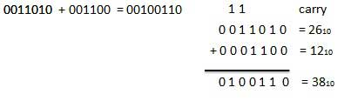
Binary addition
 | Rule#1 | Rule#2 | Rule#3 | Rule#4
A | 0 | 0 | 1 | 1
B | 0 | 1 | 0 | 1
A+B | 0 | 1 | 1 | 0 (CARRY 1)

Slide 39
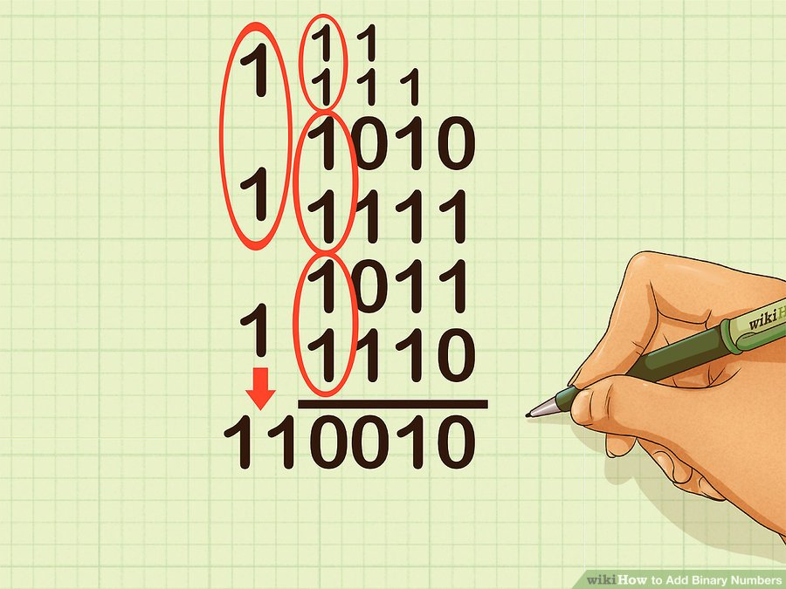
Binary addition

Slide 40
Binary subtraction
Subtraction and Borrow, these two words will be used very frequently for the binary subtraction. There are four rules of binary subtraction.
 | Rule#1 | Rule#2 | Rule#3 | Rule#4
A | 0 | 1 | 1 | 0
-B | 0 | 1 | 0 | 1
A - B | 0 | 0 | 1 | 1 (BORROW 1)

Slide 41
Binary subtraction
BORROW |  | 1 | 1 | 1
A | 1 | 0 | 1 | 0 | 1
-B | 0 | 1 | 1 | 1 | 0
A - B | 0 | 0 | 1 | 1 | 1

